Slide 1

Supervised Learning
Presented by:
Elizer Ponio Jr.
Department of Computer Science
College of Computing and Information Technologies

Slide 2
Outline
Recap of Machine Learning
Types of Machine Learning
Data and Dataset
What is Supervised Learning?
Notes:
Have you asked yourself the question, why do people organize?
Lets go to the psychology of organizing
This predictability applies within the context of our homes, manifesting through the concept of organization

Slide 3
Recap of Last Lesson
Machine learning is a subarea of Artificial intelligence.
Machine learning gives computers the ability to learn and make decisions based on data and not from explicit instructions
Example: Predicting the next value of Fahrenheit
Celsius: | 0 | 8 | 15 | 22 | 38
Fahrenheit: | 32 | 46.4 | 59 | 71.6 | ???
Notes:
Have you asked yourself the question, why do people organize?
Lets go to the psychology of organizing
This predictability applies within the context of our homes, manifesting through the concept of organization

Slide 4
Recap of Machine Learning
Types of Machine Learning
Data and Dataset
What is Supervised Learning?
Notes:
Have you asked yourself the question, why do people organize?
Lets go to the psychology of organizing
This predictability applies within the context of our homes, manifesting through the concept of organization

Slide 5
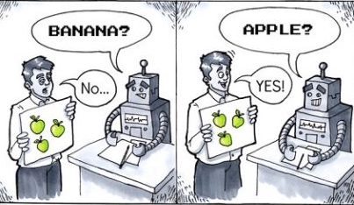
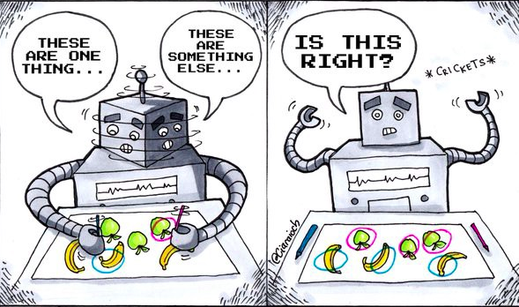

Types of Machine Learning
Supervised Learning
Unsupervised Learning
Reinforcement Learning
Notes:
Have you asked yourself the question, why do people organize?
Lets go to the psychology of organizing
This predictability applies within the context of our homes, manifesting through the concept of organization

Slide 6





Definitions
Supervised Learning | Unsupervised Learning | Reinforcement Learning
Computer learns by making use of labeled data | Computer learns by making use of unlabeled data | Reinforcement Learning uses an agent that takes actions in an environment. It uses a system of rewards and punishments
Apple
???
Mango
Grapes
???
???
Notes:
Example of unsupervised learning:
Cluster books into different categories on the basis of the title and other book information but not by knowing its actual category

Slide 7

Applications
Supervised Learning | Unsupervised Learning | Reinforcement Learning
Malware Clustering
Stock Prediction
Chess
Sentiment Analysis
Book Clustering
Dota 2
Notes:
Have you asked yourself the question, why do people organize?
Lets go to the psychology of organizing
This predictability applies within the context of our homes, manifesting through the concept of organization

Slide 8
Recap of Machine Learning
Types of Machine Learning
Data and Dataset
What is Supervised Learning?
Notes:
Have you asked yourself the question, why do people organize?
Lets go to the psychology of organizing
This predictability applies within the context of our homes, manifesting through the concept of organization

Slide 9

What is Data?
Data is any relevant information represented as text, numbers, or images.
Examples:
- User information (age, gender etc.)
- Image attributes (measurements,
color etc.)
Machine Learning is fun!
Notes:
Have you asked yourself the question, why do people organize?
Lets go to the psychology of organizing
This predictability applies within the context of our homes, manifesting through the concept of organization

Slide 10
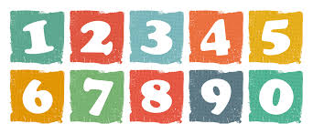
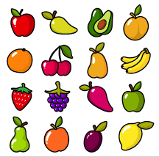
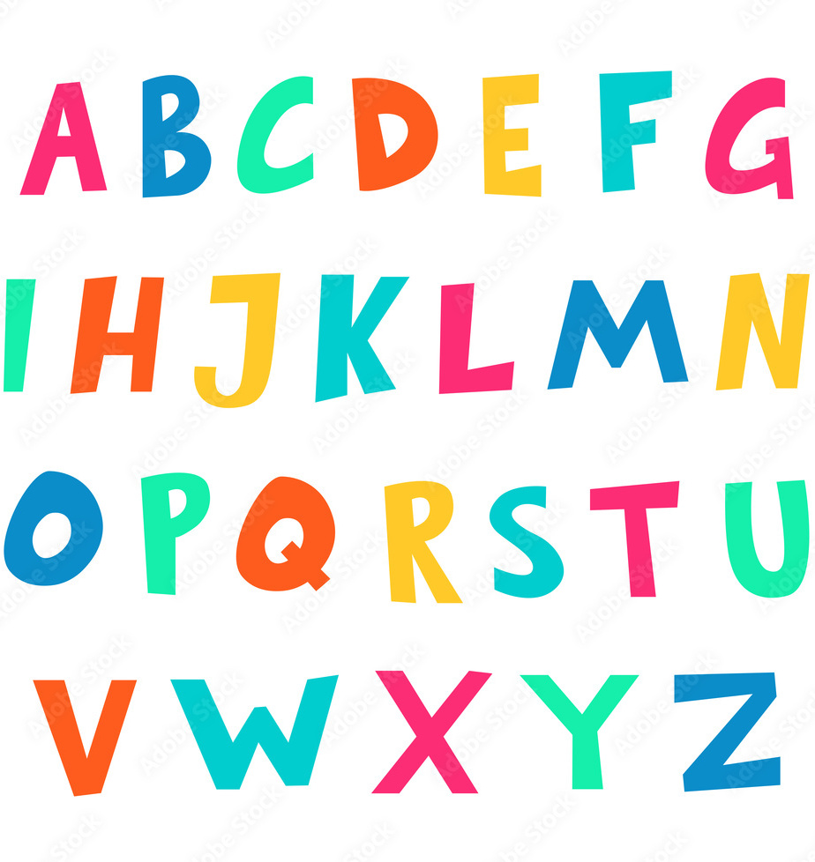
What is a Dataset?
A dataset is a set or collection of data.
Notes:
Have you asked yourself the question, why do people organize?
Lets go to the psychology of organizing
This predictability applies within the context of our homes, manifesting through the concept of organization

Slide 11
Human Features Dataset
 | Height | Body Type | Eye Color | Skin Complexion | Label
0 | Tall | Chubby | Blue | Light | Smash
1 | Average | Slim | Brown | Fair | Smash
2 | Short | Petite | Green | Dark | Pass
Features
Class/Label/Target
Notes:
Have you asked yourself the question, why do people organize?
Lets go to the psychology of organizing
This predictability applies within the context of our homes, manifesting through the concept of organization

Slide 12
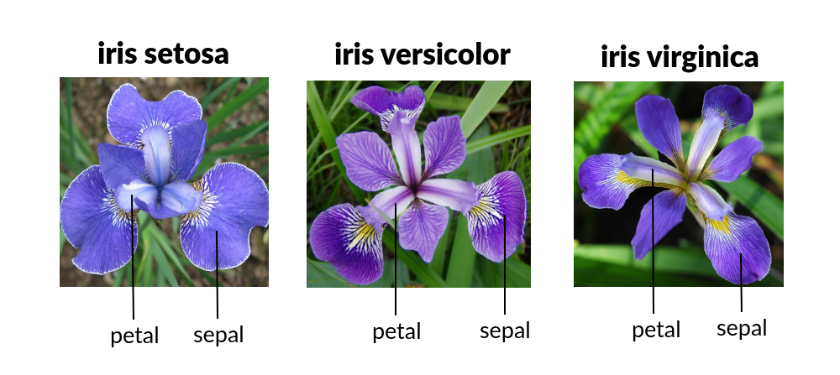
Iris Dataset
Notes:
Have you asked yourself the question, why do people organize?
Lets go to the psychology of organizing
This predictability applies within the context of our homes, manifesting through the concept of organization

Slide 13
Iris Dataset
 | Sepal Length | Sepal Width | Petal Length | Petal Width | Species
0 | 5.1 | 3.5 | 1.4 | 0.2 | Setosa
1 | 5.7 | 2.8 | 4.1 | 1.3 | Versicolor
2 | 6.3 | 3.3 | 6 | 2.5 | Virginica
Features
Class/Label/Target
Notes:
Have you asked yourself the question, why do people organize?
Lets go to the psychology of organizing
This predictability applies within the context of our homes, manifesting through the concept of organization

Slide 14
Recap of Machine Learning
Types of Machine Learning
Data and Dataset
What is Supervised Learning?
Notes:
Have you asked yourself the question, why do people organize?
Lets go to the psychology of organizing
This predictability applies within the context of our homes, manifesting through the concept of organization

Slide 15
What is Supervised Learning?
Supervised Learning is a type of machine learning that focuses on training models to make predictions or decisions based on labeled data
Notes:
Have you asked yourself the question, why do people organize?
Lets go to the psychology of organizing
This predictability applies within the context of our homes, manifesting through the concept of organization

Slide 16
What is Supervised Learning?
Notes:
Have you asked yourself the question, why do people organize?
Lets go to the psychology of organizing
This predictability applies within the context of our homes, manifesting through the concept of organization

Slide 17
Labeled Data
Apple
Mango
Grapes
Notes:
Have you asked yourself the question, why do people organize?
Lets go to the psychology of organizing
This predictability applies within the context of our homes, manifesting through the concept of organization

Slide 18
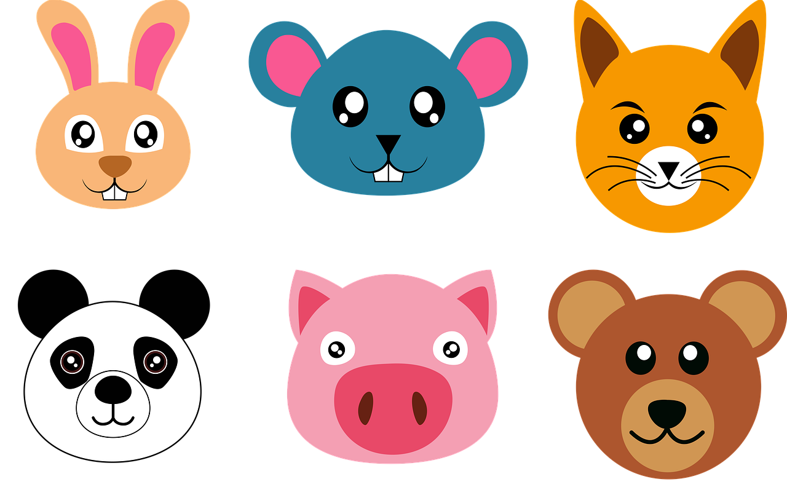
Labeled Data
Rabbit
Koala
Fox
Panda
Pig
Bear
Notes:
Have you asked yourself the question, why do people organize?
Lets go to the psychology of organizing
This predictability applies within the context of our homes, manifesting through the concept of organization

Slide 19
Training
Training Data
Height | Body Type | Eye Color | Skin Complexion | Label
Tall | Chubby | Blue | Light | Smash
Average | Slim | Brown | Fair | Smash
Short | Petite | Green | Dark | Pass
Training….
Notes:
Have you asked yourself the question, why do people organize?
Lets go to the psychology of organizing
This predictability applies within the context of our homes, manifesting through the concept of organization

Slide 20
Test
Prediction: Smash
Test Data
Height | Body Type | Eye Color | Skin Complexion | Label
Tall | Slim | Amber | Fair | ????
Notes:
Have you asked yourself the question, why do people organize?
Lets go to the psychology of organizing
This predictability applies within the context of our homes, manifesting through the concept of organization

Slide 21
Tasks in Supervised Learning
Classification:
Predicting a class label
Multiclass Classification:
Example: Predicting a species of flower with two or more classes [virginica, setosa, versicolor]
Binary Classification:
Example: Smash or Pass. Two classes [Smash or Pass]
Notes:
Have you asked yourself the question, why do people organize?
Lets go to the psychology of organizing
This predictability applies within the context of our homes, manifesting through the concept of organization

Slide 22
Tasks in Supervised Learning
Regression:
Predicting a continuous value
Example: Predicting stock prices, predicting house prices, predicting IQ level of a person
Notes:
Have you asked yourself the question, why do people organize?
Lets go to the psychology of organizing
This predictability applies within the context of our homes, manifesting through the concept of organization

Slide 23
Supervised Learning Algorithms
K-Nearest Neighbor
Linear Regression
Logistic Regression
Support Vector Machines
Decision Tree
Notes:
Have you asked yourself the question, why do people organize?
Lets go to the psychology of organizing
This predictability applies within the context of our homes, manifesting through the concept of organization

Slide 24
Algorithms
Supervised Learning | Unsupervised Learning | Reinforcement Learning
K-Nearest Neighbor
K Means Clustering
Monte-Carlo
Linear Regression
Hierarchical Clustering
Temporal Difference
Logistic Regression
DBSCAN
Q-Learning
Support Vector Machines
Principal Component Analysis
Dynamic Programming
Decision Tree
Notes:
Have you asked yourself the question, why do people organize?
Lets go to the psychology of organizing
This predictability applies within the context of our homes, manifesting through the concept of organization

